Slide 1
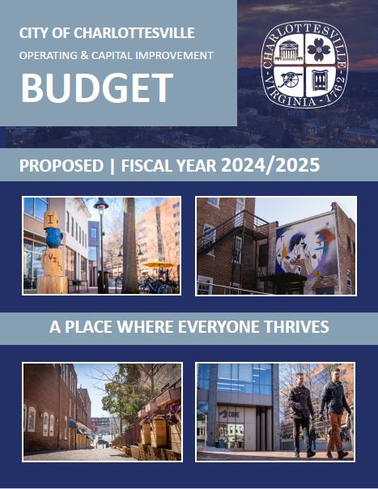
Budget Work Session
FY 2025
Budget Development
March 7, 2024

Slide 2
Agenda
Revenue Changes – FY24 to FY25
Expenditure Changes – FY24 to FY25
ARP/Year-End Surplus

Slide 3
General Fund Budget Annual Change

Slide 4
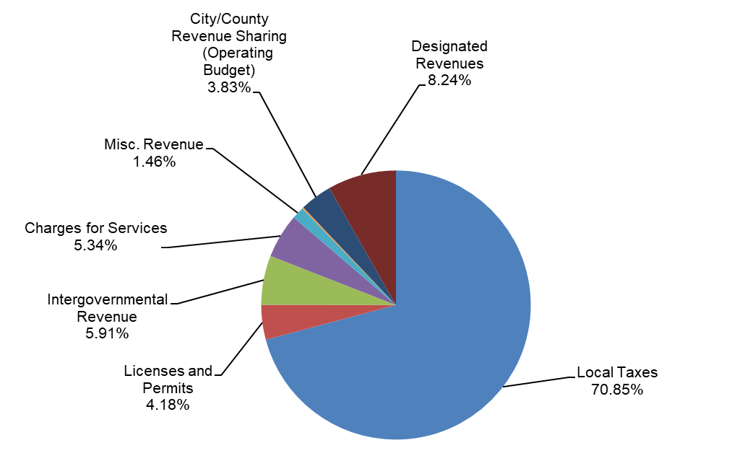
General Fund Revenue Summary

Slide 5
Revenue Changes FY24 to FY25

Slide 6
Revenue Changes FY24 to FY25 (continued)

Slide 7
Revenue Changes FY24 to FY25 (continued)

Slide 8
Value of $0.01

Slide 9
FY2025 Operating Expenditure Changes

Slide 10
FY2025 Operating Expenditure Changes (continued)

Slide 11
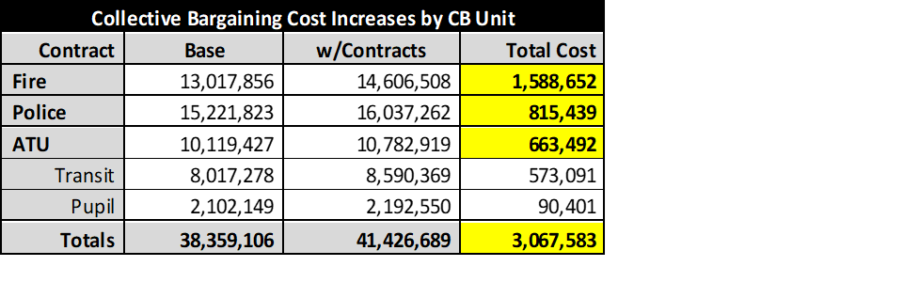
Collective Bargaining

Slide 12
FY2025 Operating Expenditure Changes (continued)

Slide 13
FY2025 Operating Expenditure Changes (continued)

Slide 14
FY2025 Operating Expenditure Changes (continued)

Slide 15
ARP Funds Update
City received a total of $19.6M in two equal tranches (June 2021 and June 2022)
City Council allocated funds into two main categories: Revenue Replacement and ARPA Projects
All ARP funds have been appropriated:
  $18.0M for 64 projects
  $1.6M unallocated
To date
  $12.7M has been spent
  $489K obligated to be spent
  $6.5M balance to be spent

Slide 16
ARP Funds Update (continued)
DECEMBER 31, 2024 DEADLINE
All ARP funds must be “obligated” or returned to UST. “Obligated” means “an order placed for a property and services and entry into contracts, subawards, and similar transactions that require payment.”
City Manager has tasked Director of Finance to ascertain obligation status of the projects with a balance in order to formulate recommendation for City Council’s consideration before 12/31/24 deadline.

Slide 17
FY23 Year End Surplus Appropriation

Slide 18
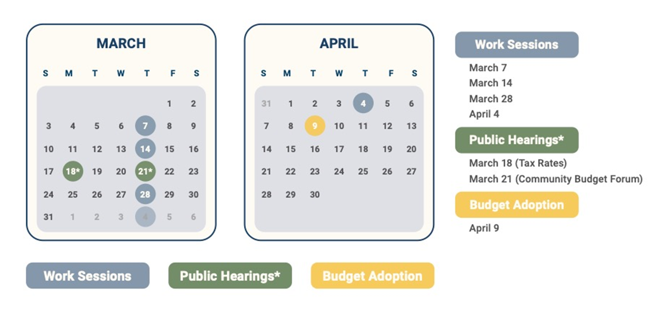
Important Budget Dates

Slide 19
Questions and Discussion
www.Charlottesville.gov/budget
Notes:
May require more than one slide

